Slide 1

Operator-Framework Workshop
automated, effective, and scalable operators
Red Hat Partner Lifecycle Engineering

Slide 2
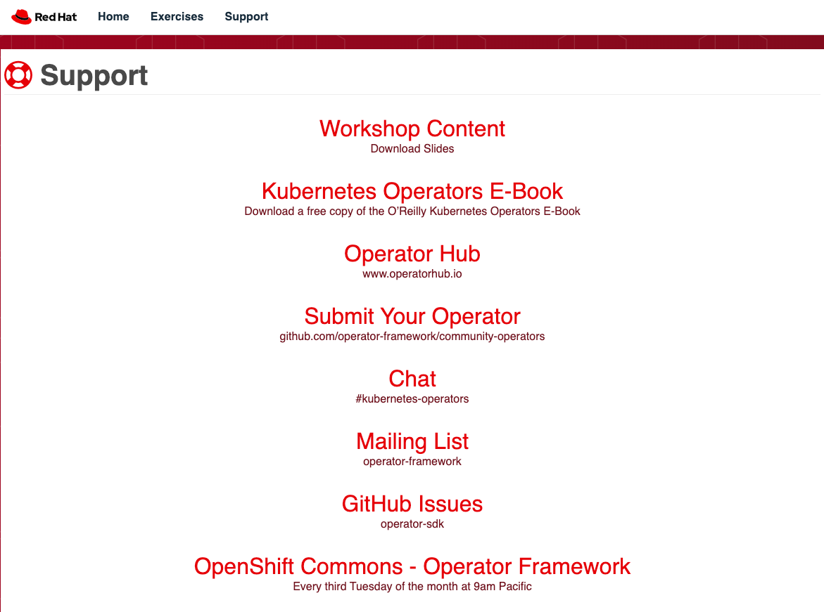
What is an Operator
workshop.coreostrain.me/support

Slide 3
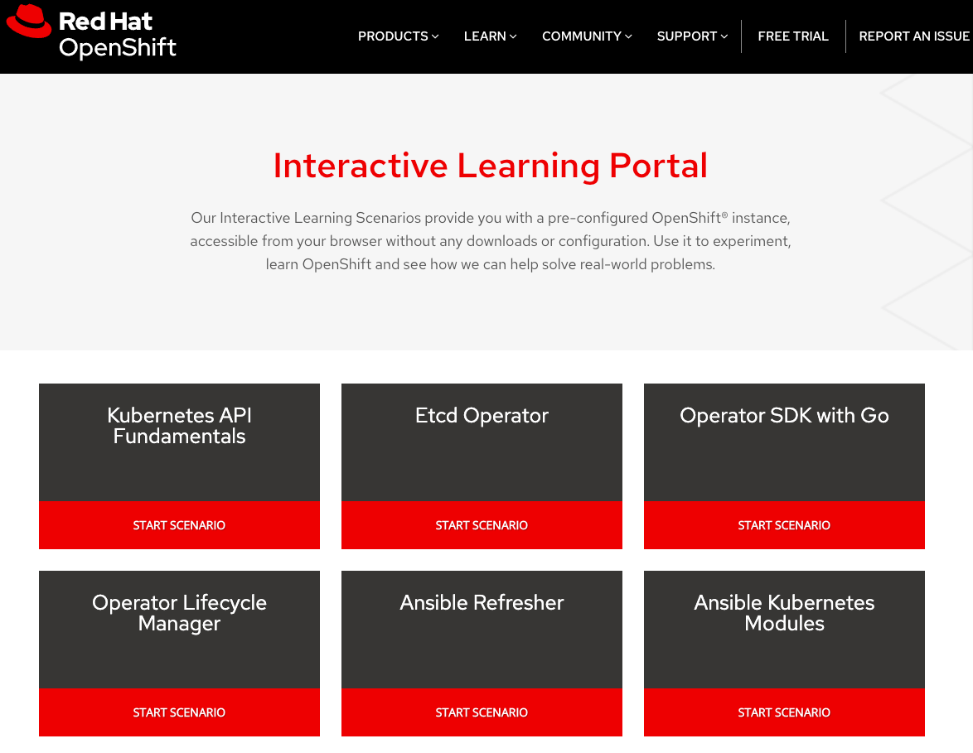
What is an Operator
learn.openshift.com/training

Slide 4
What is an Operator?
How many people here use Kubernetes and/or OpenShift regularly?
Who develops in Golang regularly?
Does anyone use Ansible regularly?
How many of you have attempted to build a custom Kubernetes controller from scratch?
Has anyone tried the Operator-SDK, Ansible-Operator, or Helm-App Operator?

Slide 5
What we’ll discuss today
Agenda
Introduction
Making the Case for Operators
What is an Operator?
Controllers
Resources
Application and/or Domain Specific Knowledge
Why do Operators matter?

Slide 6
Making the Case for Operators
Introduction

Slide 7
State(less) Apps with Kubernetes
Making the Case for Operators
Notes:
No state. No backups.

Slide 8

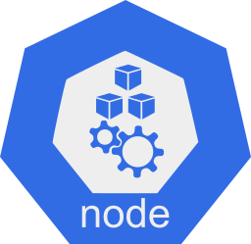


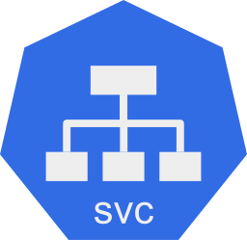

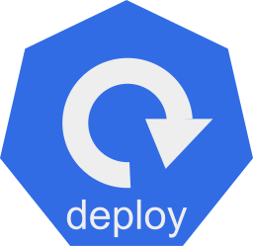
Making the Case for Operators
app.v1.0
app.v1.0
Notes:
Kubernetes native resources to deploy application

Slide 9
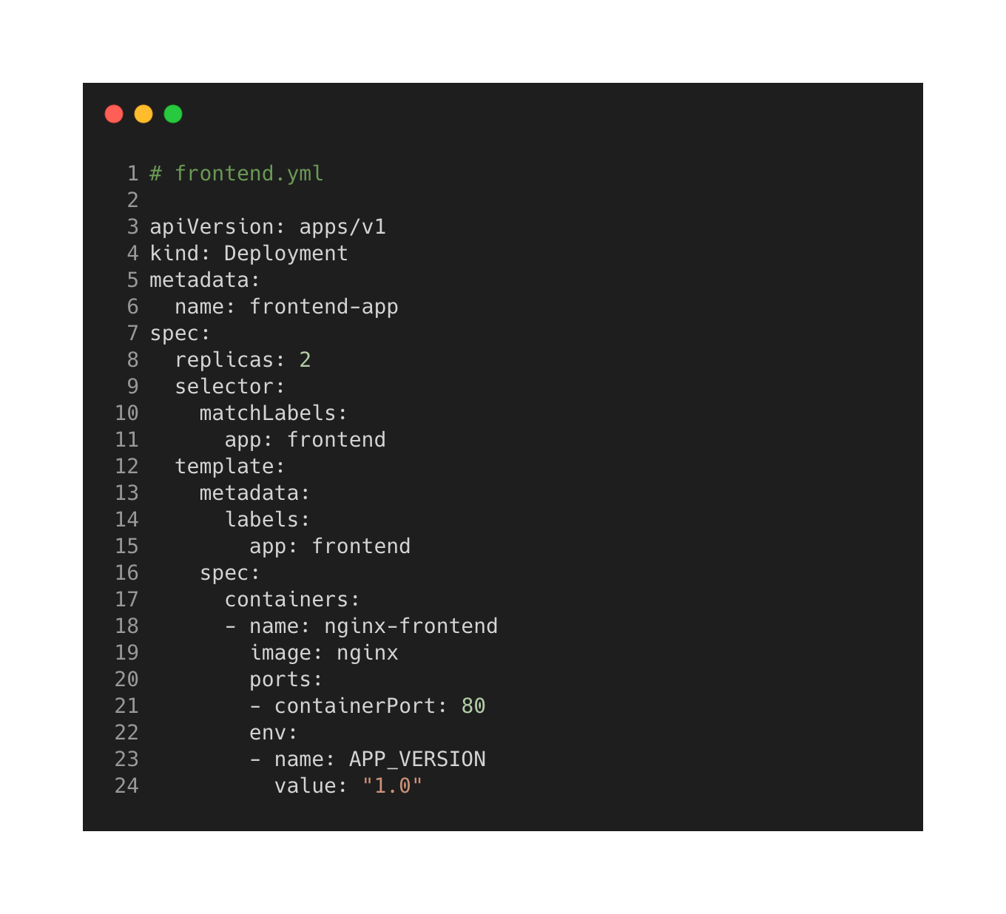
Making the Case for Operators
app.v1.0
app.v1.0
Notes:
Using a deployment and if a pod goes down another is created to take its place.

Slide 10
Making the Case for Operators
app.v1.0
app.v1.0
app.v1.0
app.v1.0

Slide 11
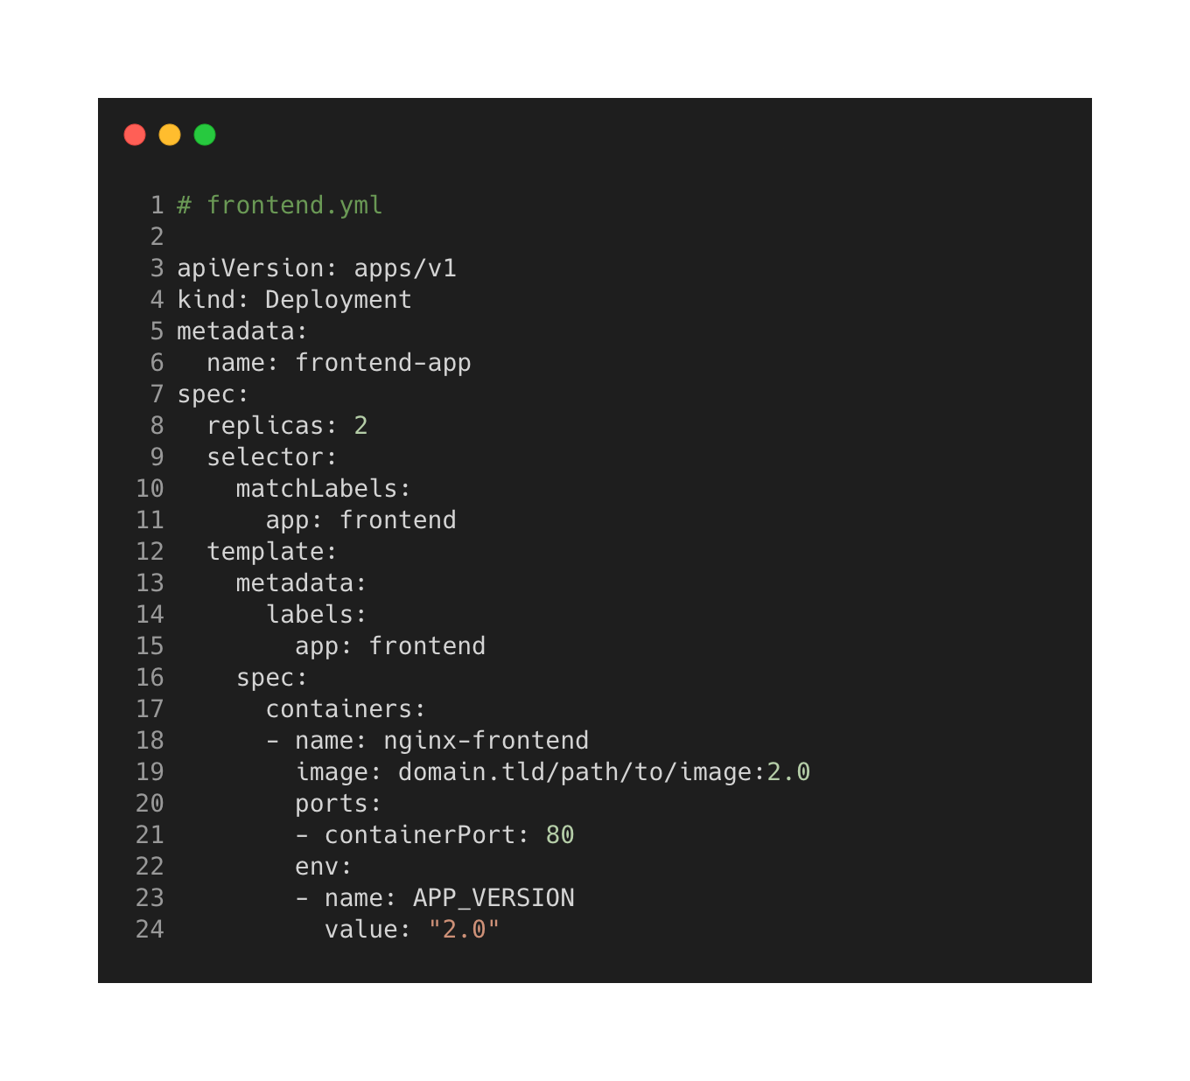
Making the Case for Operators
app.v1.0
app.v1.0

Slide 12
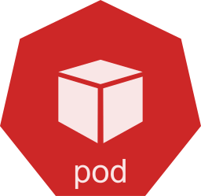
Making the Case for Operators
app.v1.0
app.v2.0
Cluster with our application. No state. No backups. Deployment update to application image starts a rollout. Our new image is deployed.
app.v1.0
app.v2.0

Slide 13
State(ful) Apps with Kubernetes
Making the Case for Operators

Slide 14

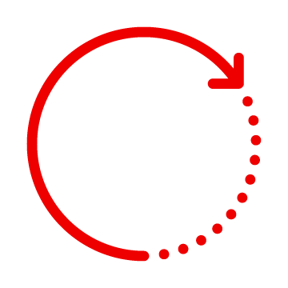
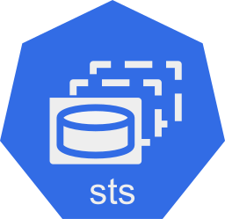
Making the Case for Operators
Installation is not as simple as spinning up a container in a pod
Replacing, Upgrading, Updating, Lifecycle Management requires human involvement
Each instance has state it needs
Deletion and Creation happen in a certain order
Synchronization and Replication has to be maintained
Activities are generally specific to the application being deployed
app.v2.0
db-0
db-1
db-2
Notes:
kubernetes does not have or maintain the knowledge to handle the lifecycle of these applications and the operator pattern fills this gap. essentially we are programming into the controller all the logic and replacing the need for human operator with a software operator.

Slide 15
What is an Operator?
Introduction

Slide 16
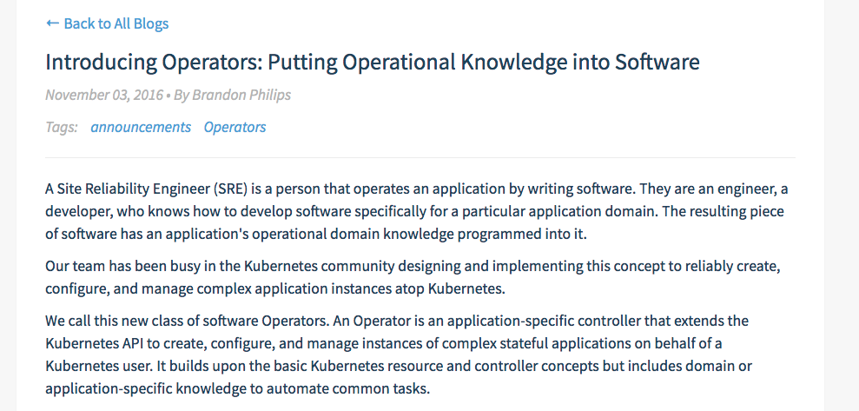
What is an Operator
Resource, Controller, and Application-Specific Knowledge
Source:
https://coreos.com/blog/introducing-operators.html

Slide 17

Operators
An operator represents human operational knowledge in software, to reliably manage an application.
What is an Operator

Slide 18
Operators
How you run and manage a particular or specific piece of complex software.
What is an Operator

Slide 19
It builds upon the basic Kubernetes resource and controller concepts but includes domain or application-specific knowledge to automate common tasks.
What is an Operator
1
2
3
Resource
Controller
Knowledge
Source:
https://coreos.com/blog/introducing-operators.html

Slide 20

What is an Operator

Slide 21
It builds upon the basic Kubernetes resource and controller concepts but includes domain or application-specific knowledge to automate common tasks.
What is an Operator
1
Resource
Source:
https://coreos.com/blog/introducing-operators.html

Slide 22
Resource^{*Custom}
an endpoint in the Kubernetes API that stores a collection of API objects of a certain kind
What is an Operator
Notes:
In our context we are talking about a Resource that we actually create via the mechanics of the Kubernetes API server. Think of this as the use of a particular kind in the API. Usually a 1 to 1 mapping of a Kind. Kind Pod => resource pod.

Slide 23


What is an Operator
Pod
the basic execution unit of a Kubernetes application–the smallest and simplest unit in the Kubernetes object model that you create or deploy. A Pod represents processes running on your Cluster.
Source:
https://kubernetes.io/docs/concepts/workloads/pods/pod/
Notes:
encapsulates an application’s container (or, in some cases, multiple containers)
storage resources
a unique network IP
options that govern how the container(s) should run.
A Pod represents a unit of deployment: a single instance of an application in Kubernetes, which might consist of either a single container or a small number of containers that are tightly coupled and that share resources.
single container pod is most common - application/binary that serves files via a hostname like example.com
multiple container pod with application/binary serving files while another is concerned only with logs from the application serving files

Slide 24
What is an Operator
ConfigMap
provides a way to inject configuration data into Pods. The data stored in a ConfigMap object can be referenced in a volume of type configMap and then consumed by containerized applications running in a Pod.
Source:
https://kubernetes.io/docs/concepts/storage/volumes/#configmap

Slide 25
What is an Operator
Secret
an object that contains a small amount of sensitive data such as a password, a token, or a key. Such information might otherwise be put in a Pod specification or in an image. Users can create Secrets and the system also creates some Secrets.
Source:
https://docs.openshift.com/enterprise/3.0/architecture/core_concepts/routes.html

Slide 26
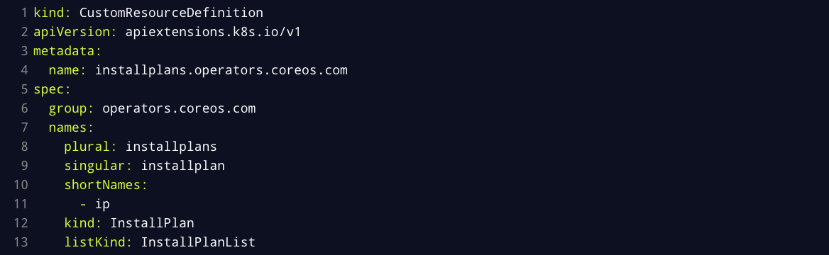
Custom Resource Definition
What is an Operator
https://kubernetes.io/docs/concepts/extend-kubernetes/api-extension/custom-resources

Slide 27
It builds upon the basic Kubernetes resource and controller concepts but includes domain or application-specific knowledge to automate common tasks.
What is an Operator
1
2
Resource
Controller
Source:
https://coreos.com/blog/introducing-operators.html

Slide 28
Controller
control loop that watches the state of your cluster and moves the current cluster state closer to the desired state
What is an Operator
Notes:
Loop that reads desired state, current state, and/or external state then reconciles or makes all the changes necessary to move current state to desired state and writing down an relevant observations. https://github.com/kubernetes/kubernetes/tree/master/pkg/controller

Slide 29
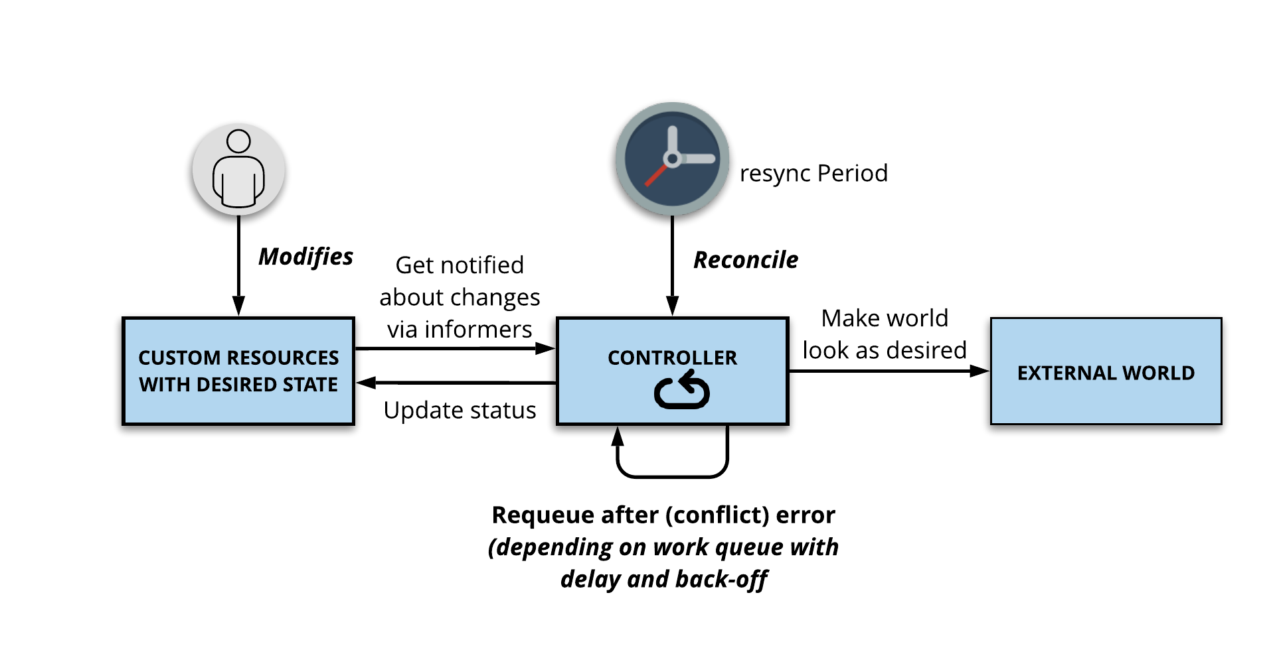
What is an Operator

Slide 30
All operators ARE controllers but NOT ALL controllers are operators
Controller ≠ Operator
Operator = Controller
What is an Operator
Notes:
Loop that reads desired state, current state, and/or external state then reconciles or makes all the changes necessary to move current state to desired state and writing down an relevant observations.

Slide 31
Kubernetes Controller
What is an Operator
control loop
watch
check
differences
act

Slide 32
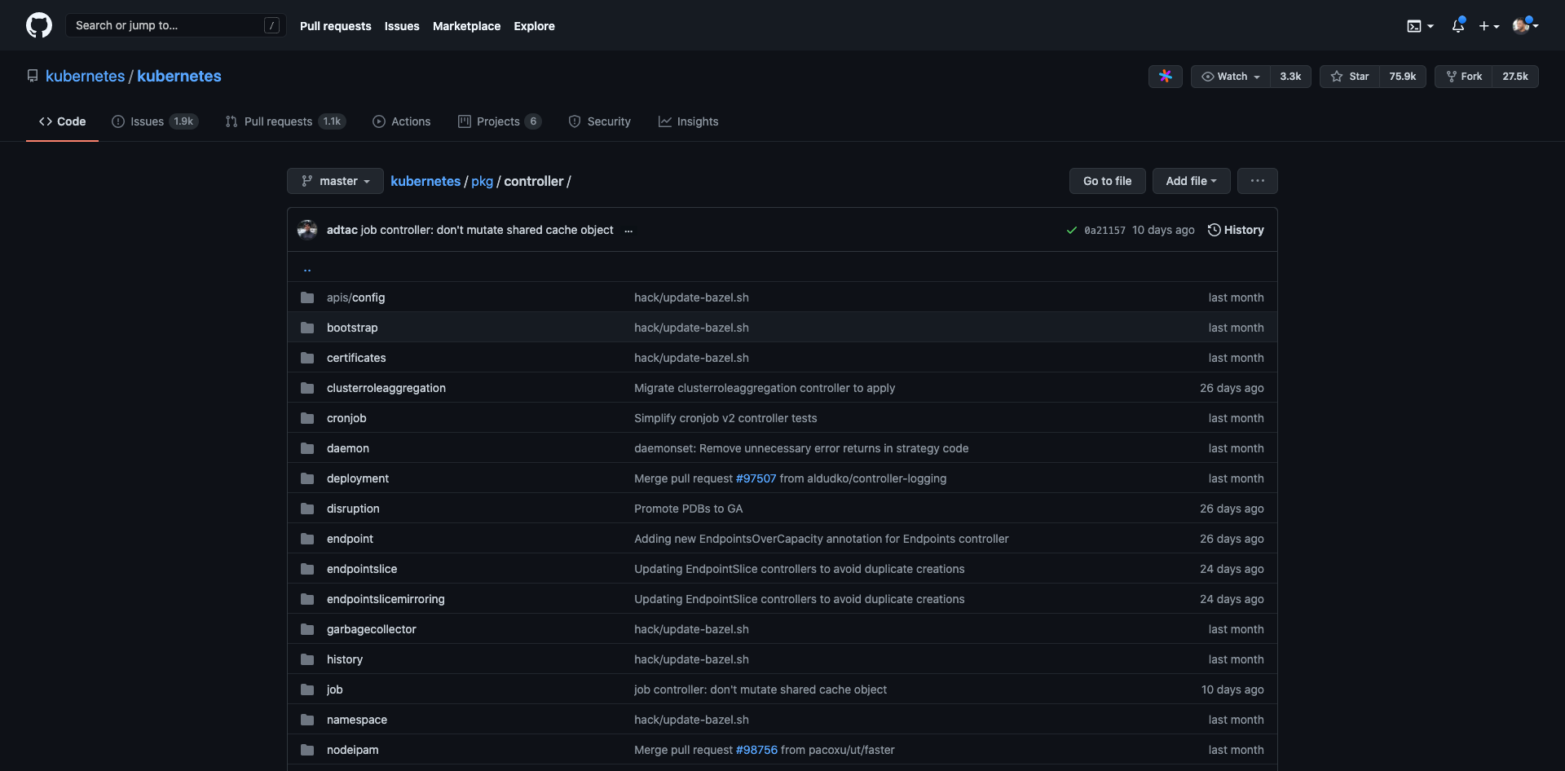
Controllers in Kubernetes
What is an Operator
https://github.com/kubernetes/kubernetes/tree/master/pkg/controller

Slide 33
What is an Operator
ReplicaSet Controller
defined with fields, including a selector that specifies how to identify Pods it can acquire, a number of replicas indicating how many Pods it should be maintaining, and a pod template specifying the data of new Pods it should create to meet the number of replicas criteria.
Source:
https://kubernetes.io/docs/concepts/workloads/controllers/replicaset/
Notes:
unless you require custom update orchestration or don't require updates at all use a deployment

Slide 34
What is an Operator
Deployment Controller
provides declarative updates for Pods and ReplicaSets. You describe a desired state in a Deployment, and the Deployment Controller changes the actual state to the desired state at a controlled rate.
Source:
https://kubernetes.io/docs/concepts/workloads/controllers/deployment/
Notes:
You describe a desired state in a Deployment, and the Deployment Controller changes the actual state to the desired state at a controlled rate

Slide 35
What is an Operator
DaemonSet Controller
ensures that all (or some) Nodes run a copy of a Pod. As nodes are added to the cluster, Pods are added to them. As nodes are removed from the cluster, those Pods are garbage collected.
Source:
https://kubernetes.io/docs/concepts/workloads/controllers/daemonset/
Notes:
node monitoring
log collection/shipping

Slide 36
It builds upon the basic Kubernetes resource and controller concepts but includes domain or application-specific knowledge to automate common tasks.
What is an Operator
1
2
3
Resource
Controller
Knowledge
Source:
https://coreos.com/blog/introducing-operators.html

Slide 37
Knowledge
domain or application specific; usually must be learned from users and/or administrators rather than developers
What is an Operator

Slide 38

Domain or Application Specific Knowledge
What is an Operator
real-world experience with managing your application(s)
Install
Self Heal
Scale
Update
Backup
Clean Up
Observability
Resiliency
Notes:
Lifecycle

Slide 39
Relational Database Operations
What is an Operator
Installing database software
Creating databases
Performing upgrades of the database and software to new releases
Starting and shutting down the database instance
Managing the storage structures of the database
Managing users and security
Managing database objects, such as tables, indexes, and views
Backing up the database and performing recovery operations when necessary
Monitoring the state of the database and taking preventive or corrective action as required
Monitoring and tuning database performance
Diagnosing and reporting critical errors
https://docs.oracle.com/database/121/ADMQS/GUID-CC7F51A1-9F19-43CC-905B-C9E2006D7937.htm

Slide 40
It builds upon the basic Kubernetes resource and controller concepts but includes domain or application-specific knowledge to automate common tasks.
What is an Operator
OPERATORS
1
2
3
Resource
Controller
Knowledge
Source:
https://coreos.com/blog/introducing-operators.html

Slide 41
Why do Operators matter?
What is an Operator

Slide 42
Why Operators matter to Red Hat?
What is an Operator
Build an ecosystem of software on OpenShift that can be as easy, safe, and reliable to use and operate as a Cloud Service.
Low-touch, remotely managed, one-click-updates.

Slide 43
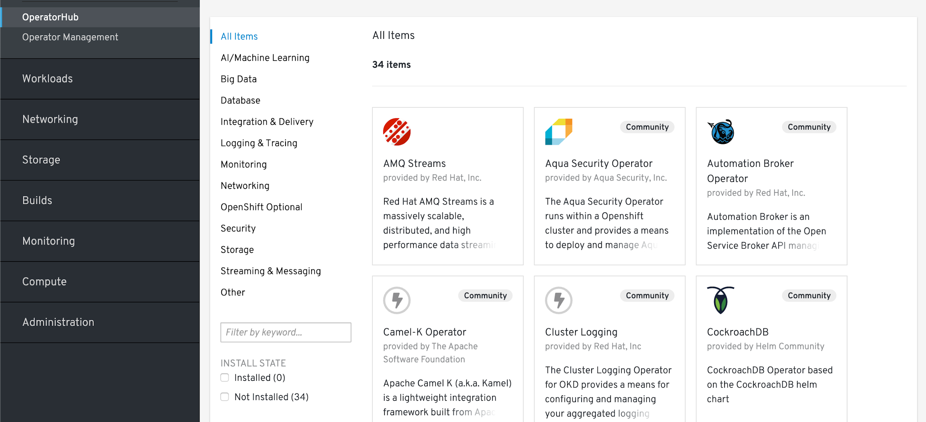
What is an Operator

Slide 44
Why Operators matter to Open Source?
What is an Operator
Build an ecosystem of software that can be as easy, safe, and reliable to use and operate as a Cloud Service.
Low-touch, remotely managed, one-click-updates.
Software that works where Kubernetes works.

Slide 45
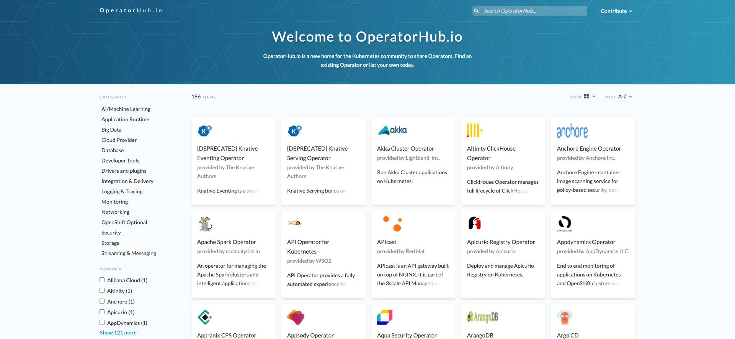
What is an Operator

Slide 46
Questions?

